Slide 1
Skin Disease Diagnosis on Darker Skin
By: Reagan Esteves, Jamie Hartman, Charles Tyndal, and Chenyu Zhao
Faculty Mentors: Dr. Zhengming Ding and Dr. Jihun Hamm

Slide 2


Slide 3
Overview
Use AI to identify skin diseases in people with darker skin tones
Why?
To address racial disparities in current AI recognition -> leads to misdiagnosis
patients unable to afford (expensive)
Image source dataset: sub-Saharan African hospitals
Focus: Buruli Ulcer, Yaw, Mycetoma, Leprosy, Scabies
Our Tasks:
Enhancing images (cropping, filtering, applying boundary boxes and masks)
Mask_RCNN & Superpixel
Our Goals:
Improve accuracy and diagnosis wait times

Slide 4
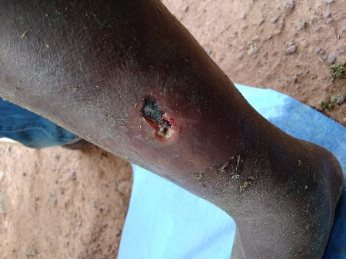
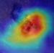
ROI Detection
[Weakly supervised Segmentation]
Aim 1: Automatic Preprocessing
Input: Raw Images
Enhancement
[Super-resolution, Color calibration]
Output 1
middle calf
[Deep learning,
Visual patterns]
[Domain adaptation, Augmentation]
Output 3
Aim 3:
Interpretation
Aim 2:
Disease Diagnosis
Output 2
Disease: buruli ulcer
Confidence: 90%
Visual Cues
Recovery Status

Slide 5
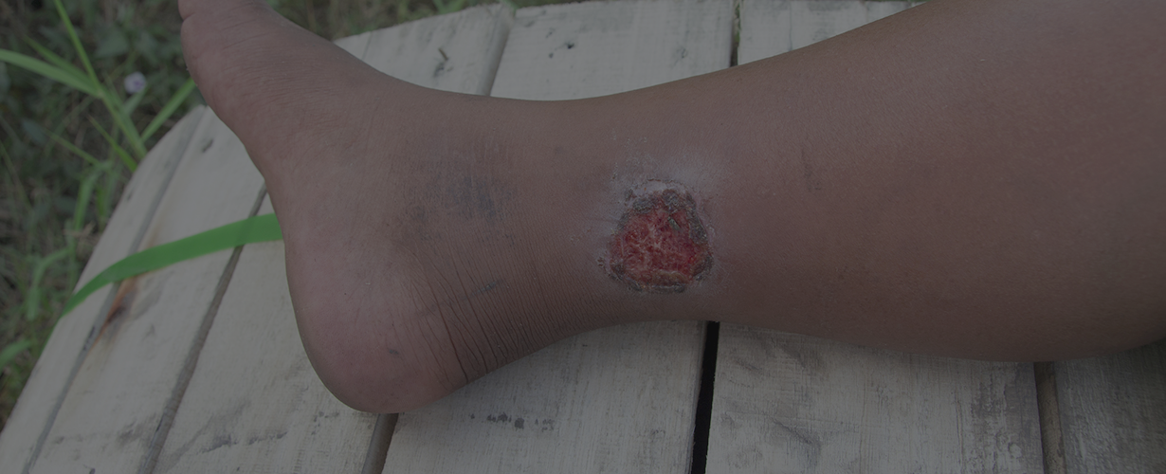
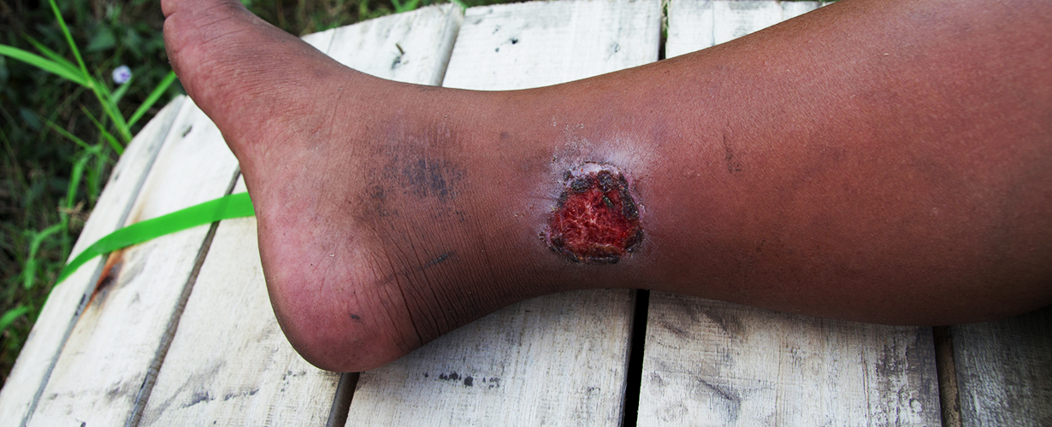
Application
Mr. A has a Buruli ulcer
Can’t meet expense and time for appointment and treatment
Solution: take a photo of the problem -> upload into our Application (Picture A)
Application crops to bodypart/area of disease
Image is enhanced (Picture B)
Diagnosis is provided: Buruli Ulcer, and the confidence level
Picture A
Picture B

Slide 6
01
Last Semester’s Results

Slide 7
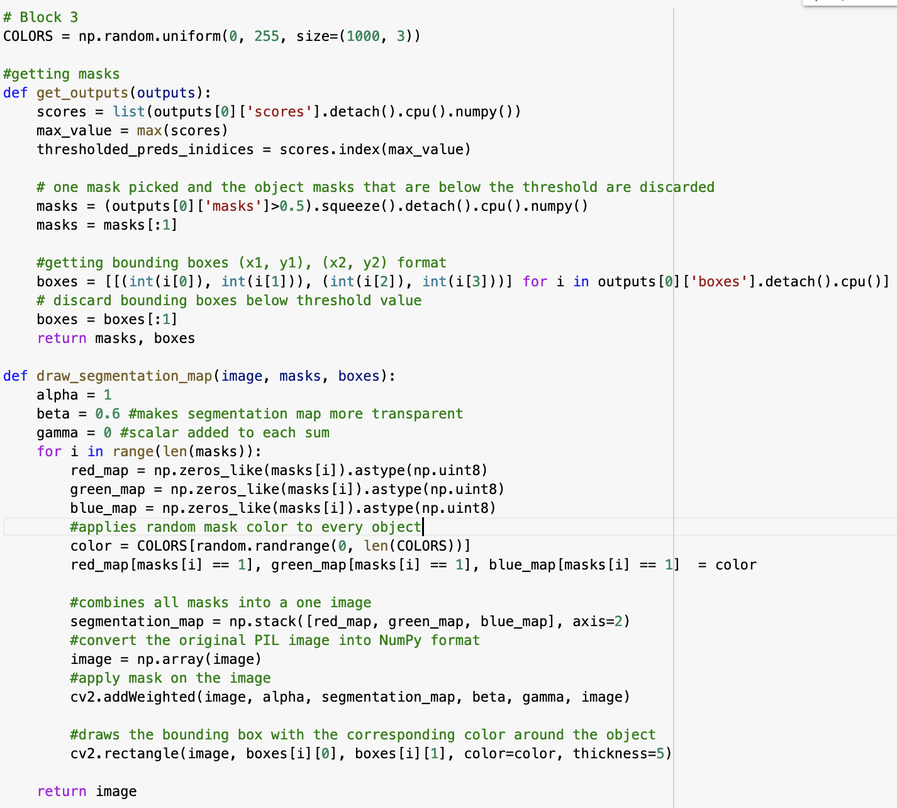
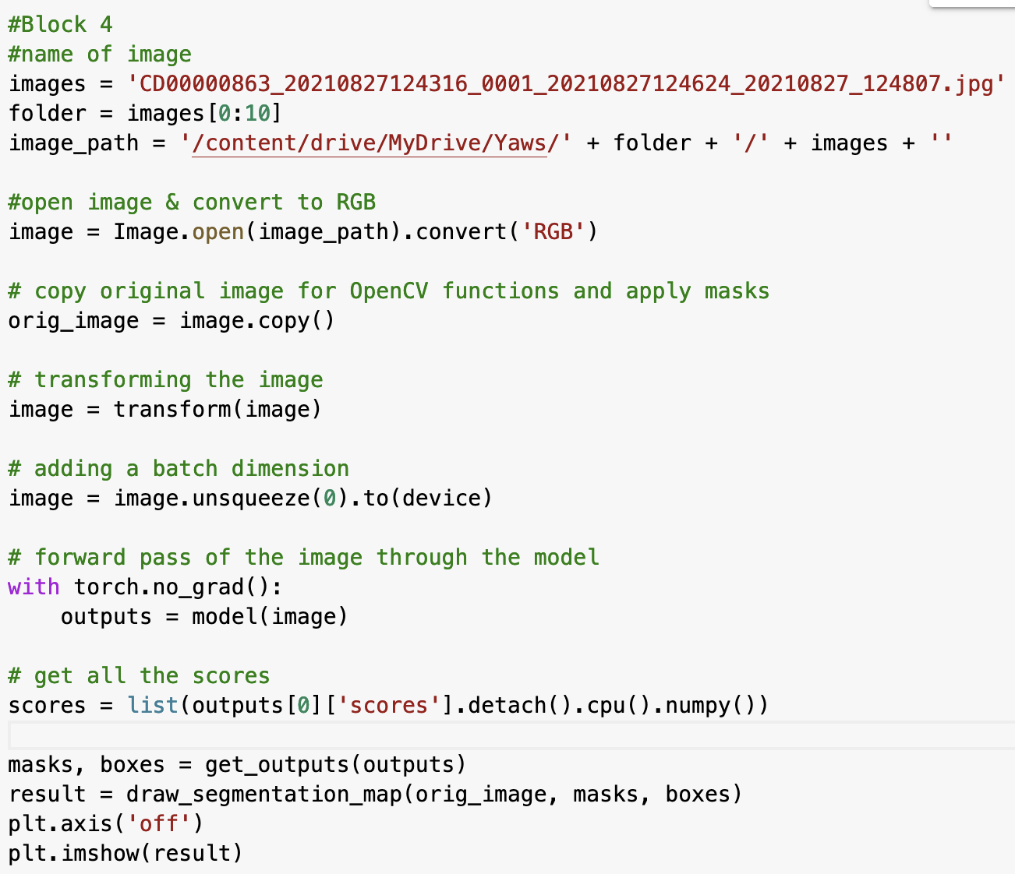
Mask RCNN
Instance segmentation, detects objects’ masks, and return object bounding boxes
Purpose:
Getting the bounding boxes and drawing the segmentation
Runs segmentation & bounding boxes through the images
‹#›

Slide 8
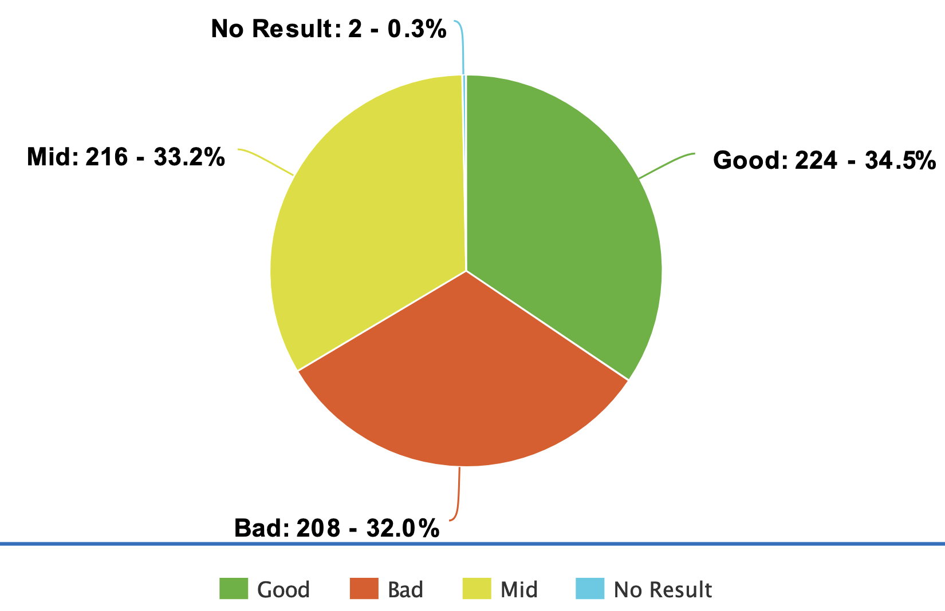
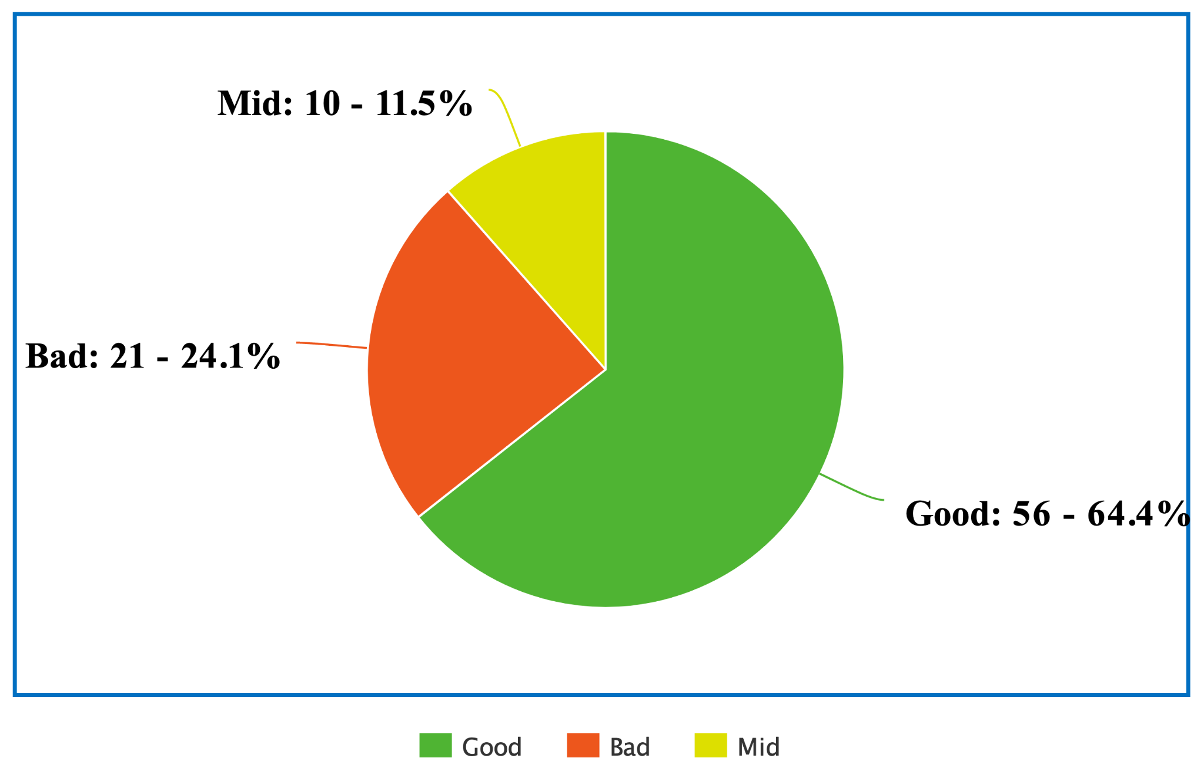
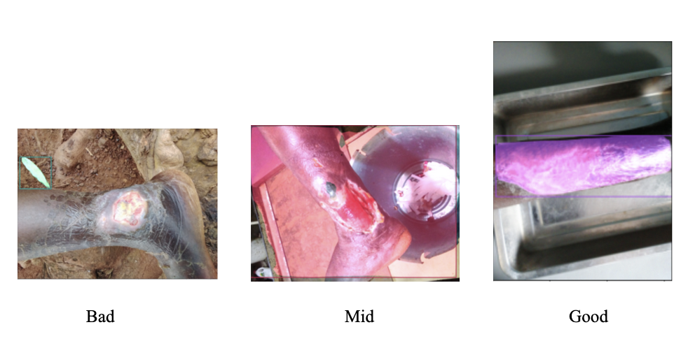
Mask RCNN Results
Ratings
Good = bounding box on body part
Mid = bounding box on body part and background
Bad= bounding box not on body part
Accuracy: Mid
Problems: Non uniform backgrounds, overexposure
Buruli Ulcer
Yaws

Slide 9
02
Milestone 6

Slide 10
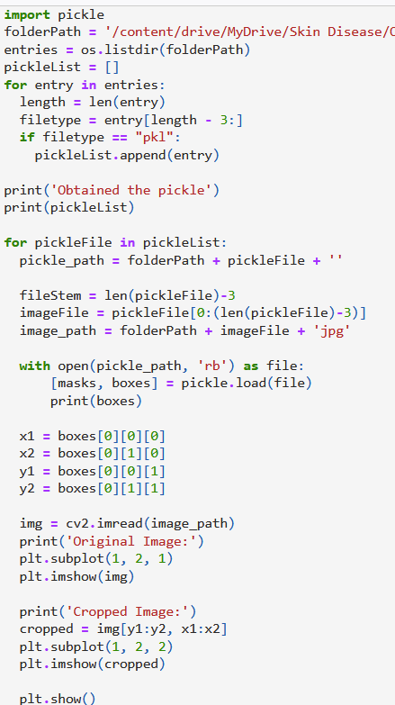
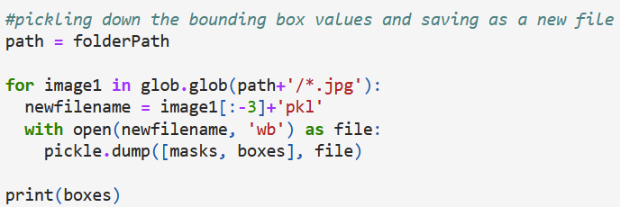
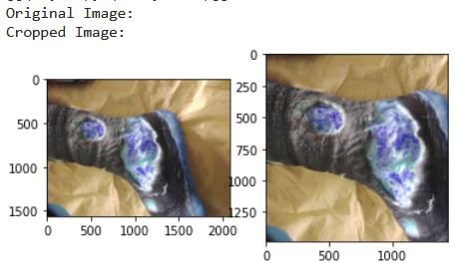
Pickling Mask RCNN & Unpickling
Purpose: Converting python object into a byte stream for easier storage and access
Pickling to the bounding box, Unpickling to view the pickled results
Pickling
Unpickling

Slide 11
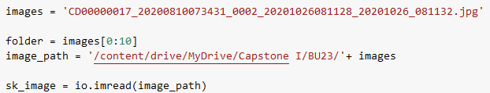
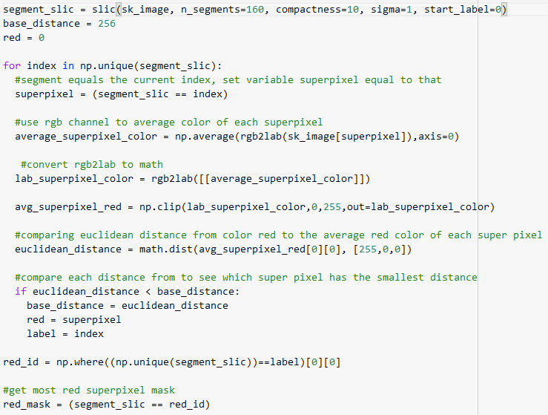
Superpixel
Clustering pixels based on shared similar visual characteristics (color)
Purpose :
To simplify and reduce the complexity of image (segmentation)
Easier skin disease recognition using the color channel
Example: Buruli Ulcer (red wound)
Use RGB channel in superpixel to find clusters of red pixels
Detect most red cluster based on euclidean and base distance
Obtain most red superpixel mask

Slide 12
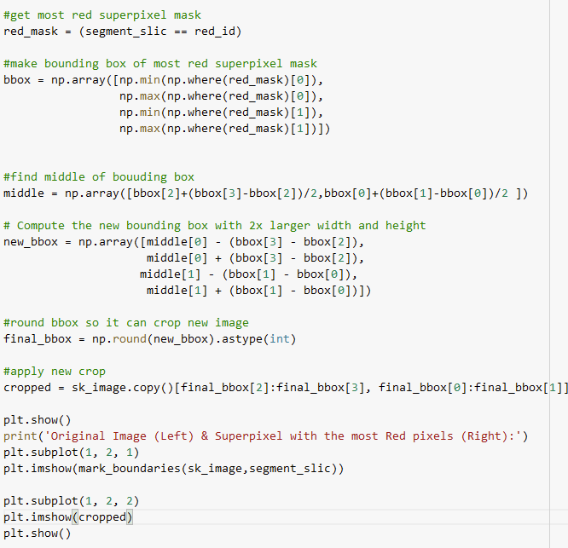
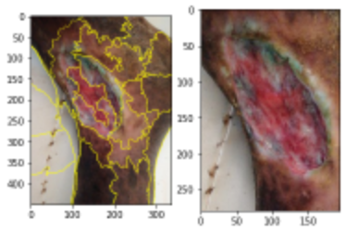
Superpixel Cropping
Purpose: crop image to skin disease area
Example: Buruli Ulcer cont’d
make bounding box on most red superpixel mask
make bounding box larger
crop to the bounding box size

Slide 13
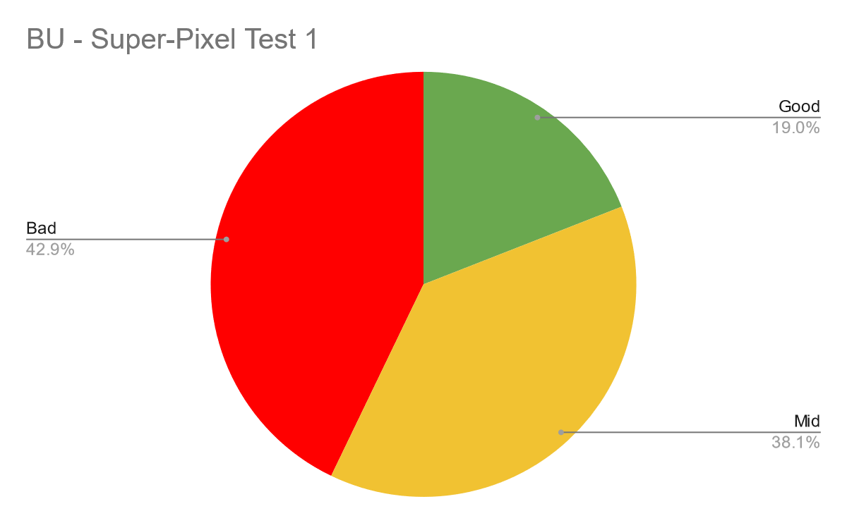
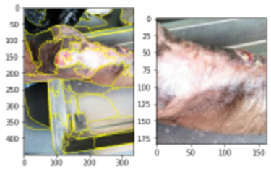
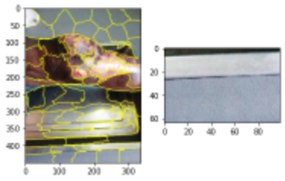
Superpixel + Crop Results (RGB) -Low Res
Good = Crop on skin disease area
Mid = Partial Crop on skin disease area
Bad = No crop on skin disease area
Accuracy : Poor
Problems: High composition of red pixels in brown and white
Good
Mid
Bad

Slide 14
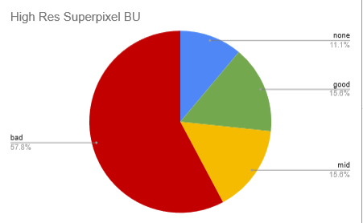
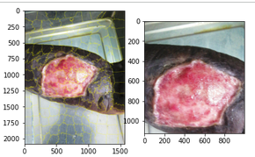
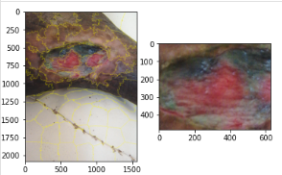
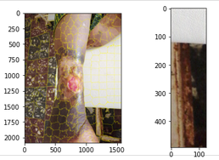
Superpixel + Crop Results (RGB) -High Res
Good = Crop on skin disease area
Mid = Partial Crop on skin disease area
Bad = No crop on skin disease area
Accuracy : Extremely Poor
Problems: Many files not working, longer run times
Good
Mid
Bad

Slide 15

Reagan Esteves:
Created code to crop superpixel based on most red superpixel
Created a HSV code prototype based on red superpixel code
Jamie Hartman:
Broke code into modular function
And created loop for multiple images at time (Mask RCNN, Superpixel, Hue, Pickling)
Charles Tyndal:
Pickle/Unpickle file creation with Mask RCNN
Created comparison file of high resolution of superpixel results
Chenyu Zhao:
Attempt of Clustering Red Superpixels for output
Created comparison file of superpixel results and pie chart
Division of Work

Slide 16
03
Future Milestone Works

Slide 17
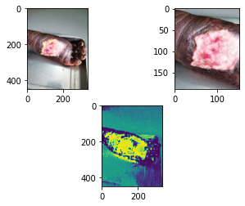
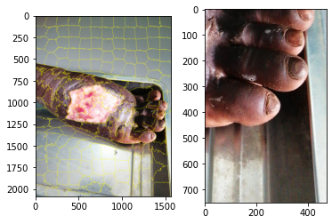
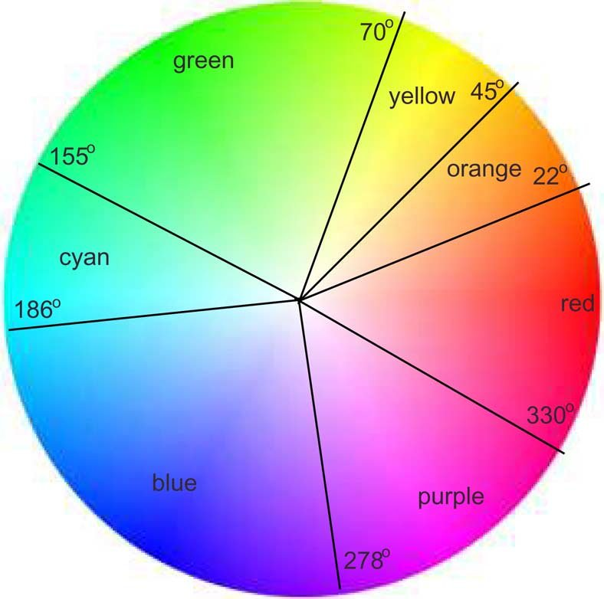
Superpixel with HSV (Hue, Saturation, Value)
Advantages
Less variance in different lightings
To remove shadows
Closer to how humans interpret and perceive color
ex. what we view is red = wound
Results:
Blue = Lower Hue
Yellow = Higher Hue
<- Hue
Superpixel ->
Notes:
Task: Comparing Mask RCNN (bad ) w/ the Superpixel HSV

